Slide 1
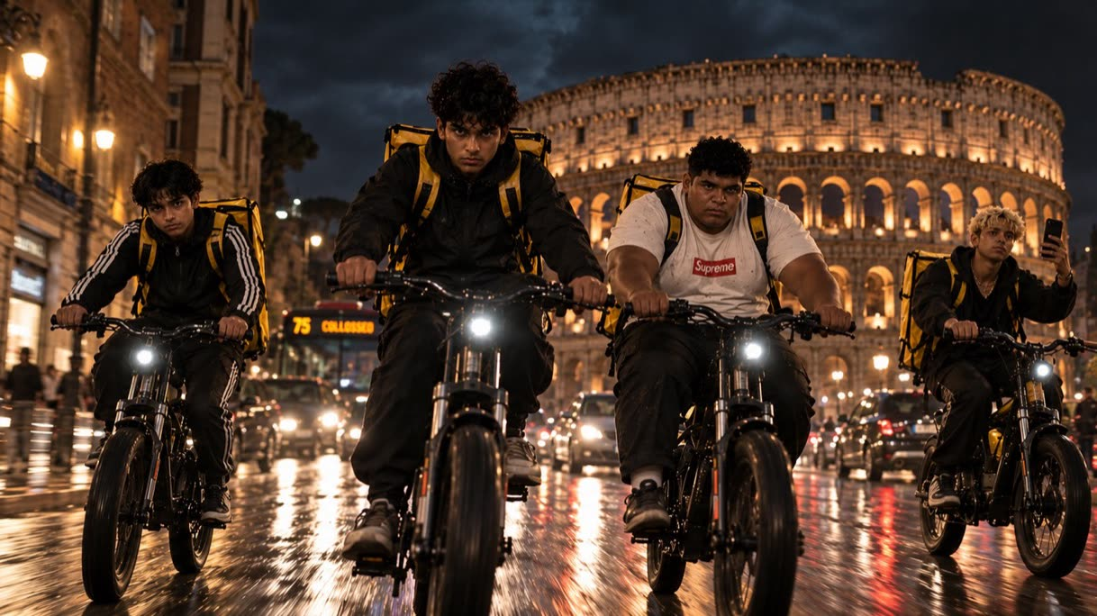



TV SERIES
8 EPISODES × 50’
CRIME · DRAMA
EAST ROME
The city is ours. Afraid of no one.
BASED ON THE STORY BY MASSIMO SCOGNAMIGLIO
Notes:
Riders on the Storm. An 8-episode TV series based on the story by Massimo Scognamiglio.

Slide 2

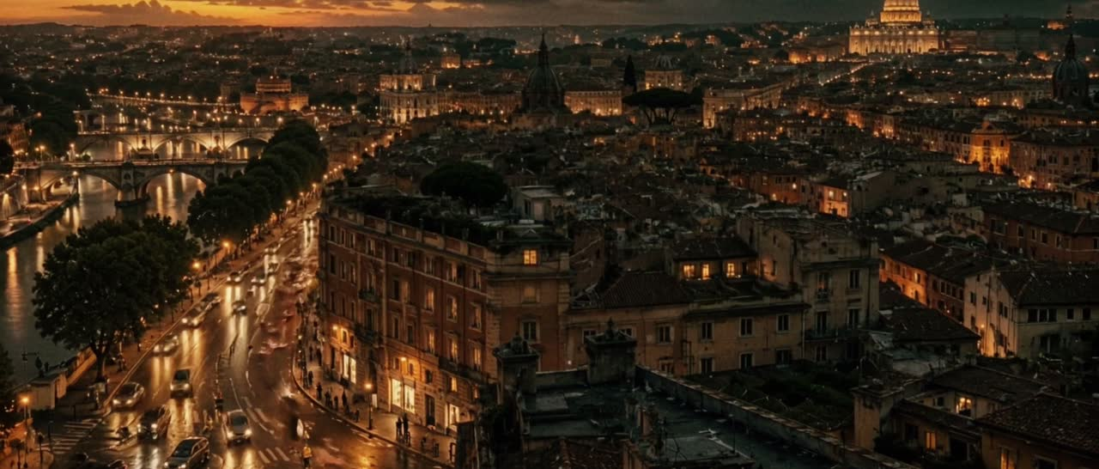
TRAILER · 1:31
Click the video to play it.
Notes:
The series trailer, 1 minute 31 seconds.

Slide 3

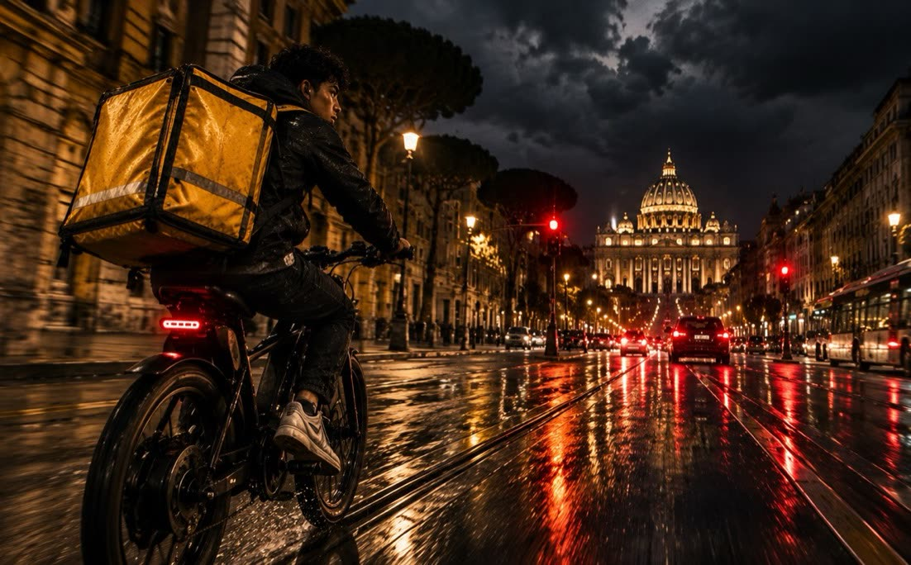
LOGLINE
Four Bengali delivery riders from East Rome steal a kilo of cocaine from the Dragona, the family that runs half the city. With the money they turn their delivery bikes into robbery machines and film every job on a social account that grows to a million and a half followers. The more people watch, the closer the end. Behind them is Apa, who keeps everyone’s accounts at the Dhaka Mini Market and tells the story.
FORMAT
GENRE
LANGUAGE
NARRATOR
8 × 50'
CRIME DRAMA
ITALIAN OR ENGLISH
APA
Season one. Season two starts from its last scene
Friendship, redemption, violence
Primary, depending on the production. Secondary: Bengali
Samira Begum, 32

Slide 4
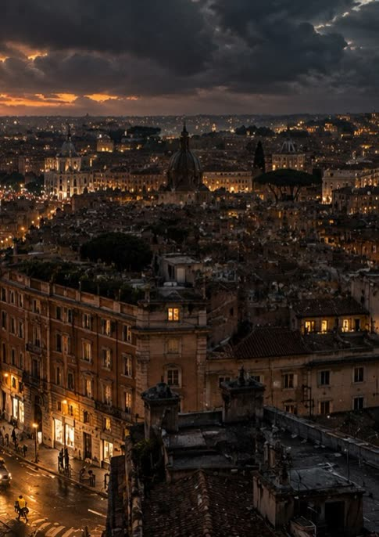

SYNOPSIS · 1 OF 2
East Rome, today. Ibrahim is a delivery rider who delivers pizzas with a surprise inside: small-time dealing. One night the surprise is pepper spray. In a Trastevere apartment he steals a kilo of cocaine from Massimo, a courier for the Dragona. With him are Rash, Ferro and Nab, who sleep on cots in his basement in Torre Angela. And there is Apa, who runs the community’s money transfer from the Dhaka Mini Market and knows everything about everyone.
Apa sells the kilo to two corrupt cops. With that money the Gang turns the bikes into robbery machines and hits the homes of wealthy Rome, on tips that pass through the Dhaka. Nab films everything for @bengalboy.it. The live robbery on Via Giulia makes them famous overnight, and every job after that tightens the hunt.

Slide 5
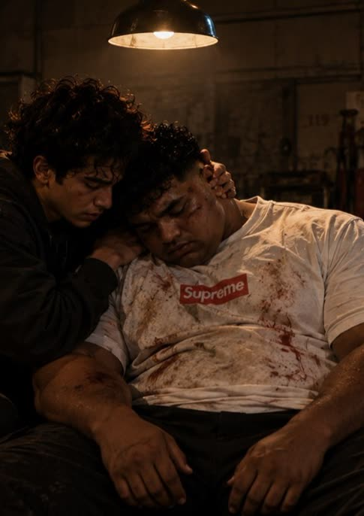

SYNOPSIS · 2 OF 2
When Babu, the community’s loan shark, hires them for a kidnapping, the Gang agrees: “once, just once.” Recognized by the hostage, Ferro kills him. At the Boishakhi Mela festival the Dragona grab Ferro, and the boys find him in a garage in Torre Spaccata when it’s too late. Ferro dies without saying a word.
Apa lures the cops, Babu and the Dragona to the same place and lets them kill each other, while the boys leave for the airport with the money. She stays at the Dhaka. Babu, the only survivor, finds her there. The season ends with a point-blank shot and a childhood memory: a boat in the flooded forest of Ratargul.

Slide 6



WHAT IT’S ABOUT
Five people who trust only each other. Ferro dies without telling the Dragona anything, his head on Ibrahim’s shoulder. Nobody wants to leave without Apa.
The boys who bring Rome its dinner without anyone looking at them decide to take the city. The city is ours. But whoever becomes king of Rome can never leave.
Violence always has a price, even when it goes out live: Massimo, Karim, Ferro, Apa. Every filmed job brings followers, and brings the Dragona closer.
“Guys, you’ve got everything ready?” “Not without you.”
“Rome was right there, waiting for someone with the nerve to take it.”
“The more visible we become, the more we’re dead.”

Slide 7
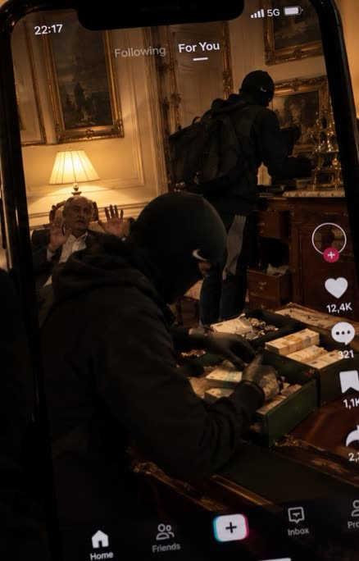



THE CENTRAL THEME
The livestreamed robberies are not a plot detail: they are the heart of the series. For the boys in the Gang, filming a job means three things at once.
Being seen is the first loot. Rash throws punches while looking into the lens, Nab zooms in on the banknotes fanning out. The job is worth as much as the video it leaves behind.
The kid who delivered dinner without anyone looking at him now has a million people waiting for the next video. Followers are reputation, a name, capital. For the first time they matter.
As in trap music, showing money, the street and violence is proof: it’s all real, we lived it. The video doesn’t tell the robbery, it certifies it. And that truth leads them straight to the Dragona.
“either it’s cinema or it’s real”

Slide 8
SUB-THEMES
INVISIBLE AND VISIBLE
THE CITY AS PREY
THE ALGORITHM
THE CHOSEN FAMILY
Those nobody looks at and those everybody watches. Being invisible is an advantage, being famous a death sentence.
Rome to take, Rome that takes you. Whoever becomes king of Rome can never leave it.
The rawer the video, the more it gets rewarded. The platform raises the stakes with every job, and the Gang follows.
The Gang as brotherhood, Apa as big sister. Five people who trust only each other.
DEBT AND SILENCE
HOME AND ROOTS
WORK AND EXPLOITATION
THE PRICE OF MERCY
Loan sharks, kidnappings, informal courts. A city inside the city, with its own laws.
Sylhet, Ratargul, the Dhaka. Who leaves, who stays, and what it means to have a home.
Riders, dishwashers, the app’s timer. A generation that delivers dinner to people who don’t see it.
Ferro gives back a watch and spares a girl. Here, kindness is the biggest risk.

Slide 9
WHY IT’S DIFFERENT
WHAT IT TAKES
WHERE IT BREAKS AWAY
THE GANG
Kids from the outskirts who want to take the city, as in Romanzo criminale.
POINT OF VIEW
An immigrant community telling its own story, with its own laws and debts.
THE MAP OF POWER
Families, dirty cops and loan sharks carving up Rome, as in Suburra.
THE VOICE
Apa narrates: she doesn’t shoot or run, but keeps the books on everything.
TENDERNESS
Affection between friends inside the violence, as in Non essere cattivo.
THE GAZE
Rome at bike height and on an app’s timer.
SOCIAL MEDIA AS TRUTH
Exhibitionism, redemption and proof of truth, like trap music.
JOY
Bangla-tech, red saris, the Boishakh new year next to the violence.

Slide 10
MARKET
WHY NOW
COMPARABLE TITLES
AUDIENCE
Every night riders cross our cities and almost nobody looks them in the face. Rome’s Bengali community is one of the largest in Europe, yet the screen has never told its story from the inside. And social media has turned violence into content and followers into power.
TOP BOY
The European crime drama audience, ages 18–44, looking for new and authentic stories. Young people who live on social media. South Asian diaspora communities in Italy and across Europe. For streaming platforms and pay TV, with international distribution.
by Ronan Bennett
The outskirts gang told by its own community
SCARFACE
by Brian De Palma
The immigrant who wants the whole city
GANGS OF LONDON
by Gareth Evans and Matt Flannery
Immigrant clans and warehouse violence
ROMANZO CRIMINALE
by Stefano Sollima, from the novel by Giancarlo De Cataldo
Kids who want to take Rome
SNOWFALL
by John Singleton, Eric Amadio and Dave Andron
The fast rise and its price

Slide 11
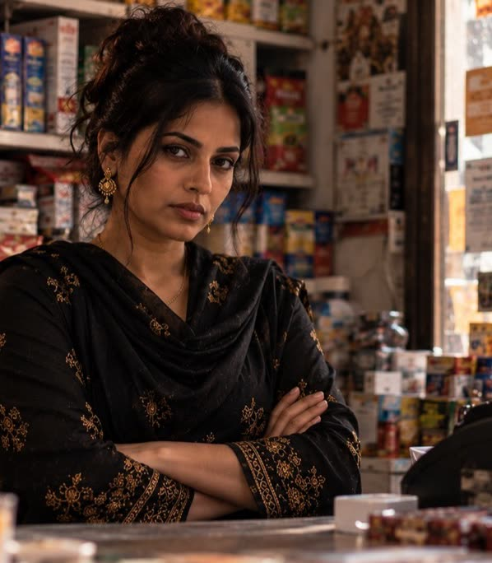




THE PLACE AS PROTAGONIST
A grocery in East Rome with two humming fridges, a camera above the till and a Mecca calendar. Money heading back to Bangladesh passes through the Dhaka, and so do the tips. It is the community’s bank, its confessional and the Gang’s operations room. A refuge at the start, a target at the end. In season two, seized by the police.
07:00
Shutter up: water, a banana, a ten-euro top-up.
09:00
The men send money home.
12:00
The riders: energy drinks, USB cables, plasters.
1st of the month
The two Italians. Voluntary contributions.
00:00
Shutter down. Apa opens her ledger.

Slide 12
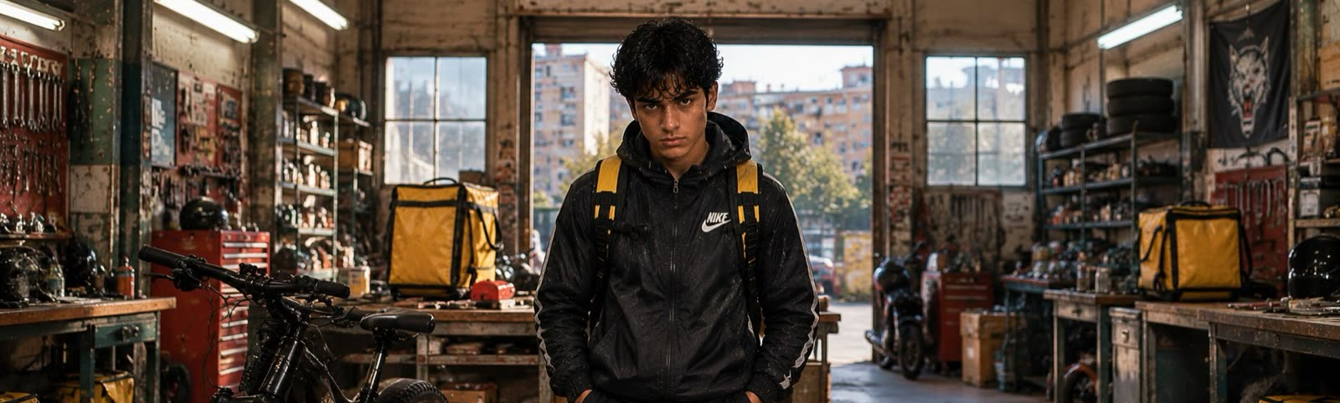
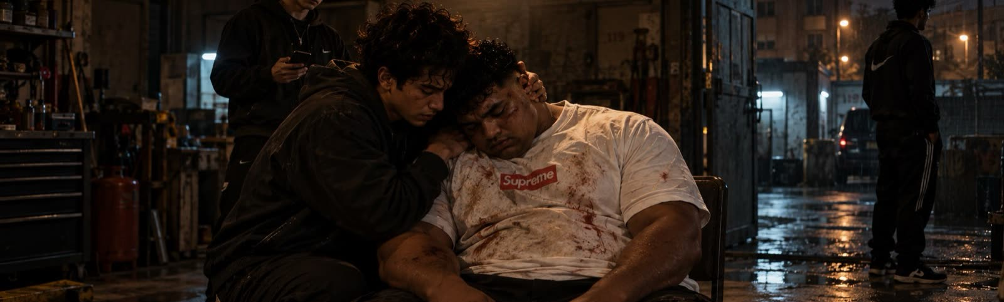
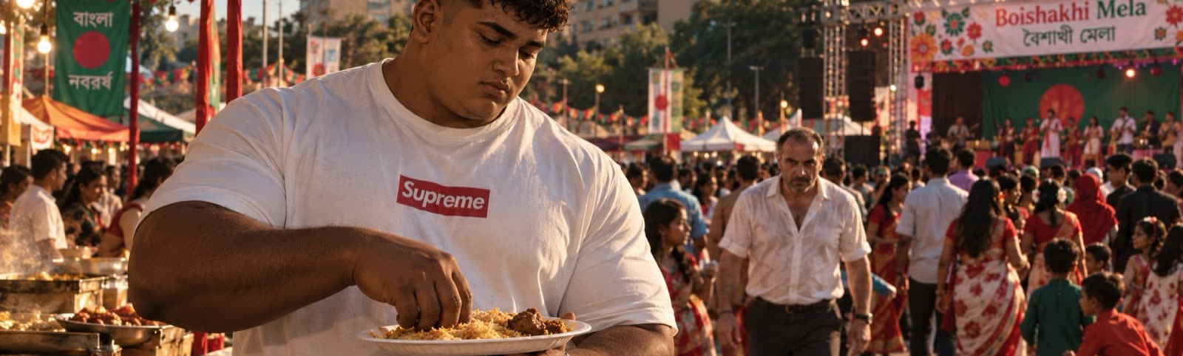
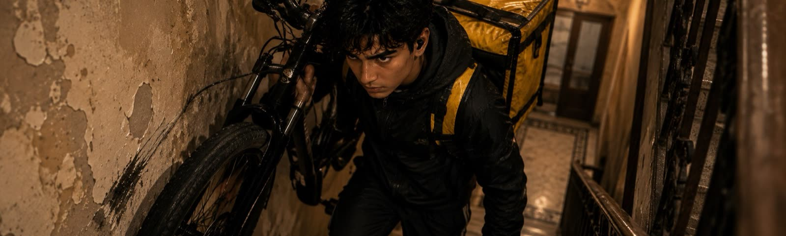
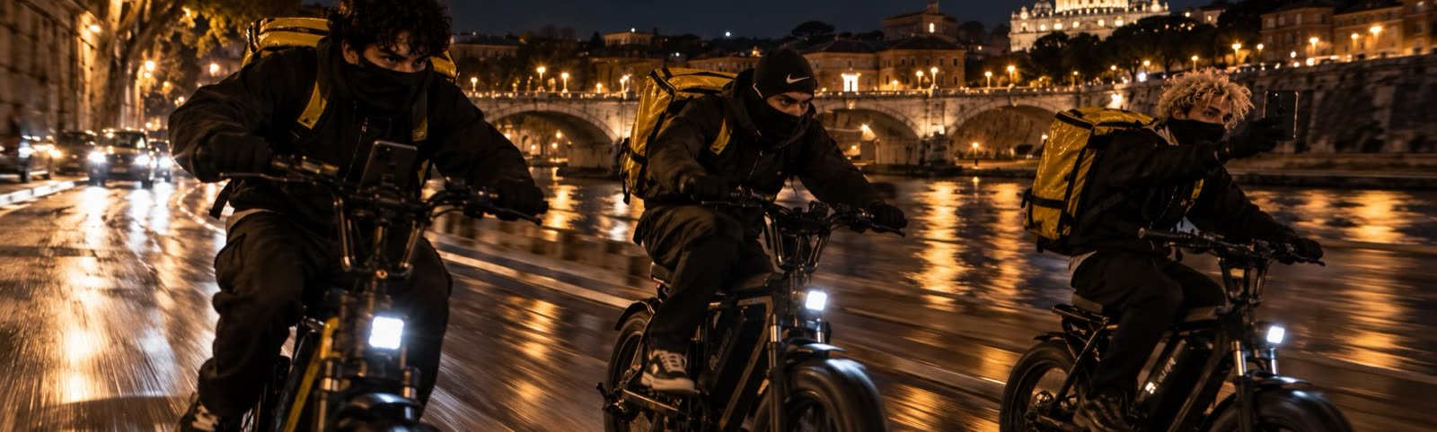
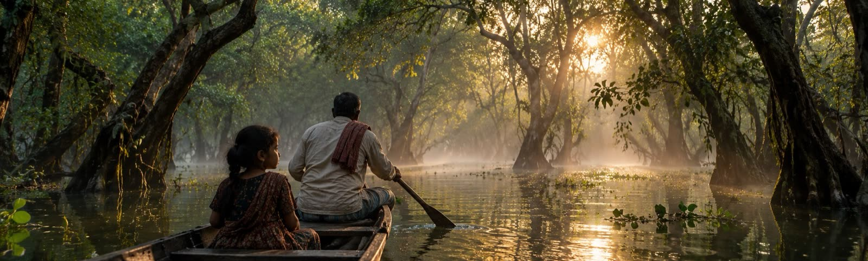
THE MAP
PONTE DI NONA
TORRE SPACCATA
LARGO PRENESTE
OFFICINA ROMANELLI
THE DRAGONA’S GARAGE
BOISHAKHI MELA
Bikes with motors in the hubs, bags with false bottoms, untraceable guns.
A green sheet-metal door, a chair in the middle, a car battery.
Red saris, coconut rice, the stage. And the Italians who didn’t come to eat.
VIA GIULIA · PARIOLI · PRATI
LUNGOTEVERE
SYLHET · RATARGUL
OTHER PEOPLE’S ROME
THE GETAWAY
THE FLOODED FOREST
The homes riders climb up to every night with a pizza. This time with a gun.
Bikes racing along the river, with Tumi Amar in their earbuds.
Apa’s memory: a boat among the trees, her father rowing.

Slide 13
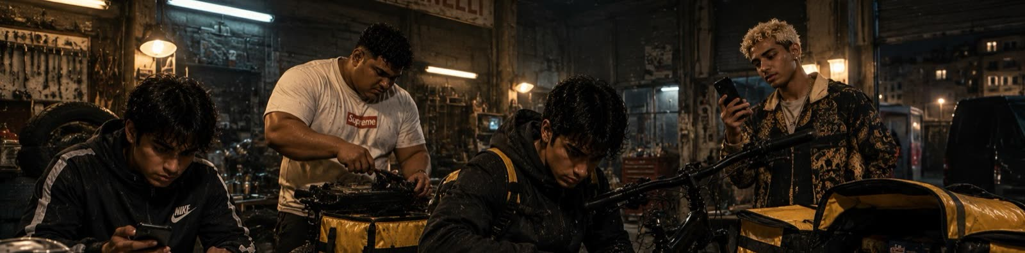
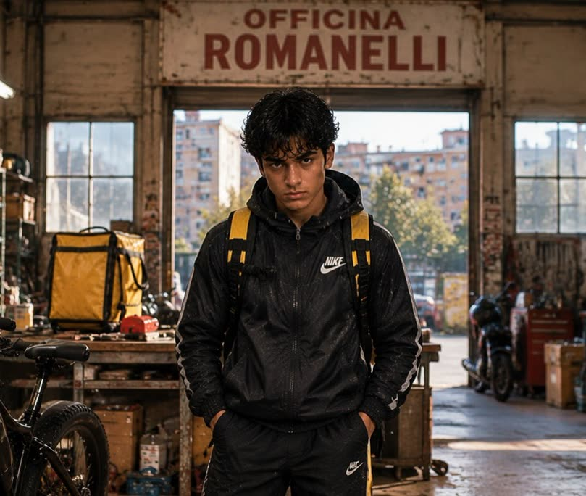
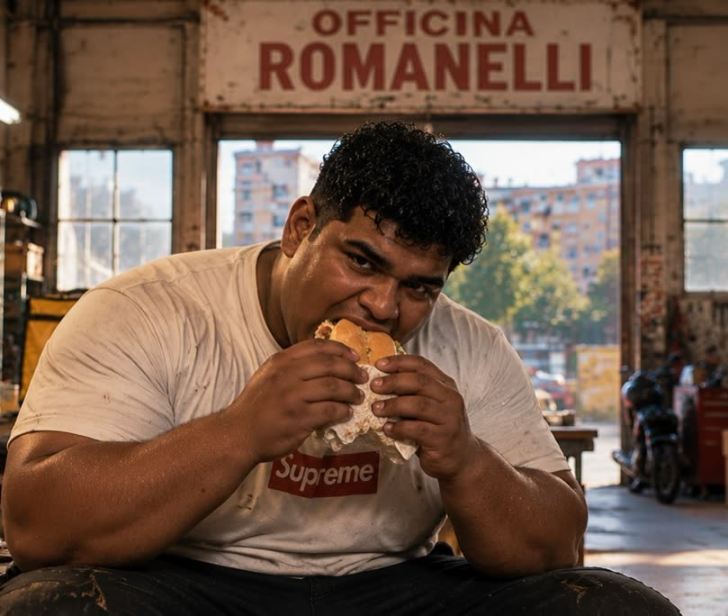
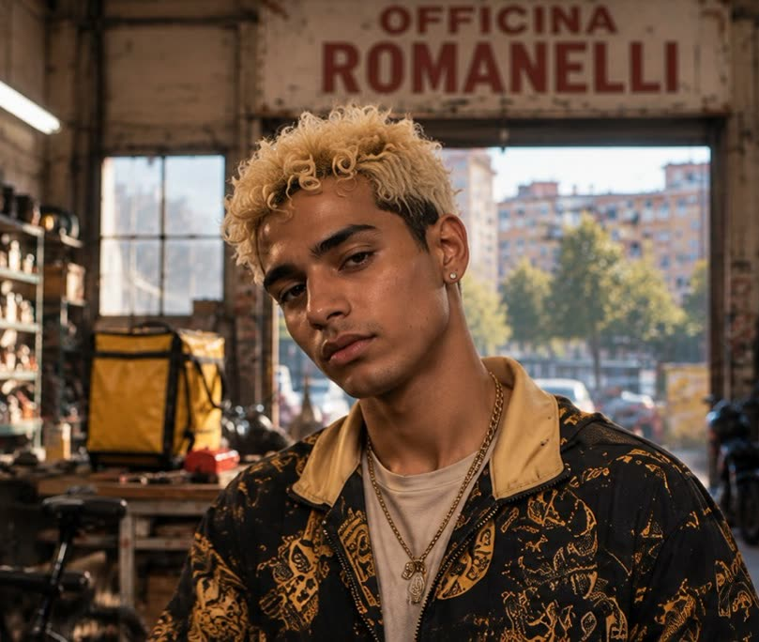
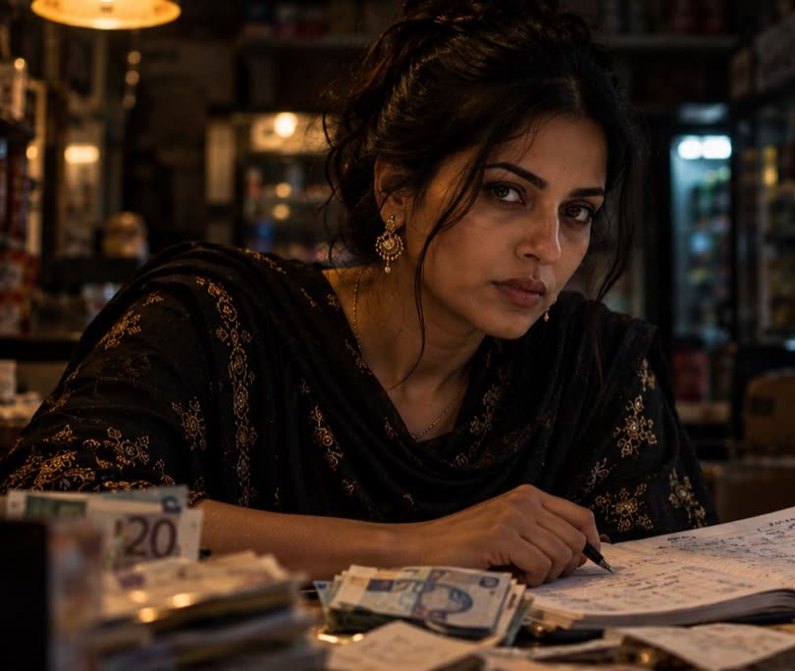
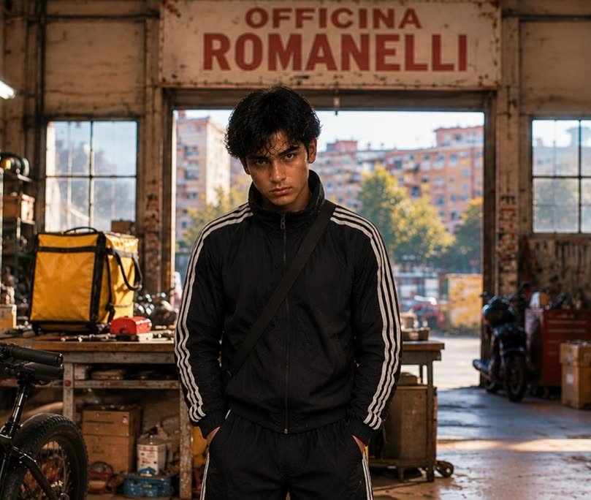





CHARACTERS · THE GANG
IBRAHIM
FARHAN MIAH
NABIL · 16
SAMIRA BEGUM · 32
RASHID KARIM · 25
The boss. The one with the idea.
The muscle. And the heart.
The eyes. And the camera.
The brain. And the voice.
The navigator.

Slide 14
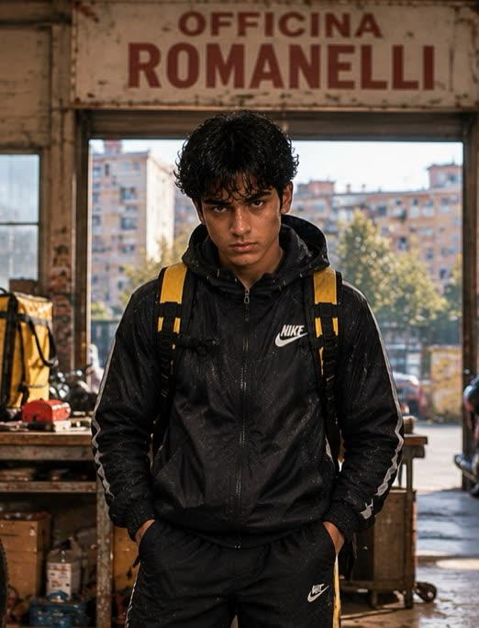

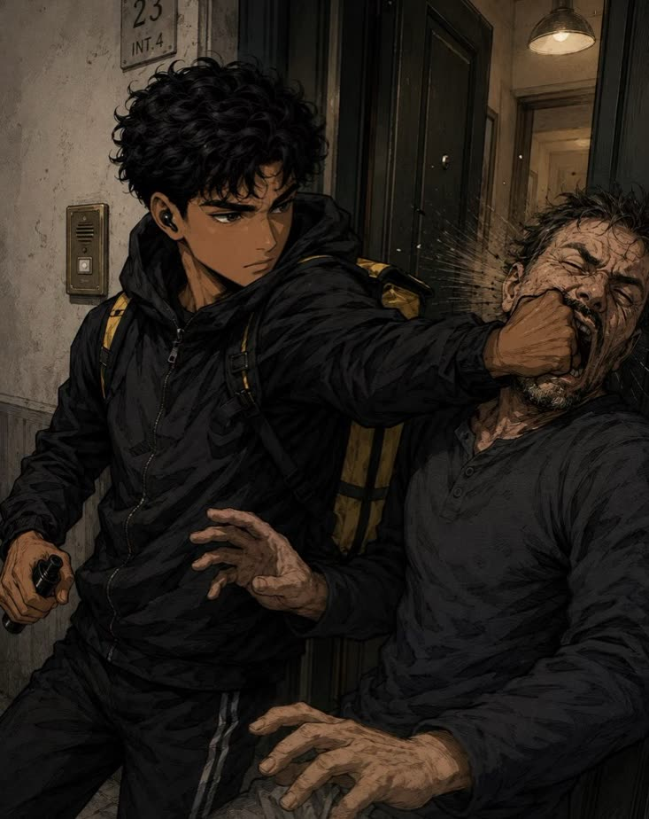
CHARACTERS
IBRAHIM
THE BOSS. THE ONE WITH THE IDEA.
The story doesn’t describe him: it shows him in action. He said Rome was right there, just sitting, waiting for someone with the nerve to take it. The others believed him. Or maybe they wanted to believe him.
Carries his bike up five flights of stairs so there’s no gap in his delivery schedule.
Empties the pepper spray into Massimo’s face and takes a kilo of the Dragona’s coke.
Counts exactly thirty seconds of silence before deciding.
Shoots first in Torre Spaccata, and holds Ferro until he dies.
SEASON ARC
From a rider who wants Rome to a king of Rome who can never leave it. His choices take the Gang to the top, and cost Ferro his life.
From the story

Slide 15
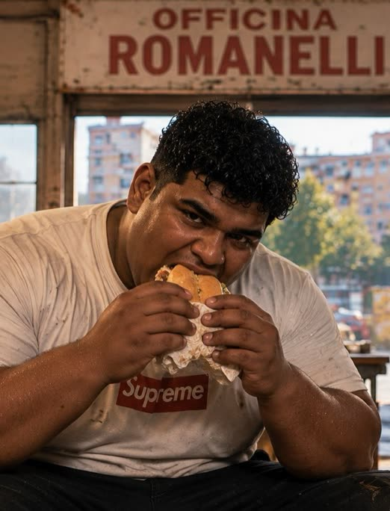

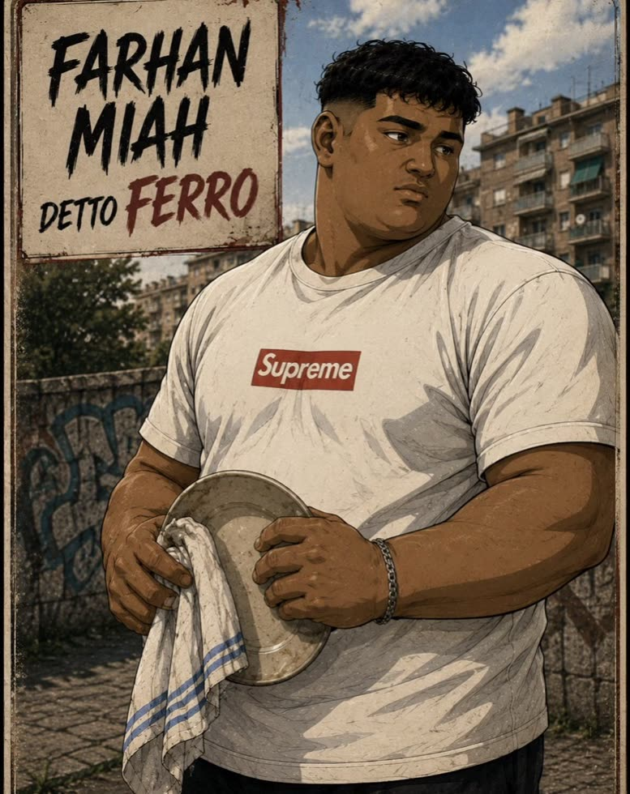
CHARACTERS
FARHAN MIAH
THE MUSCLE. AND THE HEART.
Big, bricklayer’s hands, the sweet face of a kid brother, always hungry. Washes dishes fourteen hours a day. When he walks into a room, everyone knows the conversation is over.
Before hurting anyone he waits half a second, as if asking permission.
Secretly gives the Patek back to the mother in Parioli.
Leaves the caregiver locked in the bathroom in Prati alone.
Dies in Torre Spaccata without telling the Dragona anything.
SEASON ARC
The gentle giant who gives a watch back to a mother and smothers a man who recognized him. The most human and the most vulnerable.
From the story

Slide 16
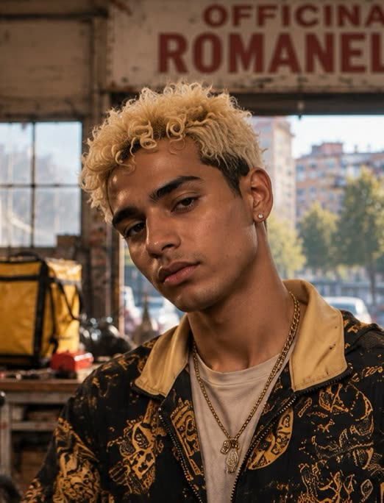

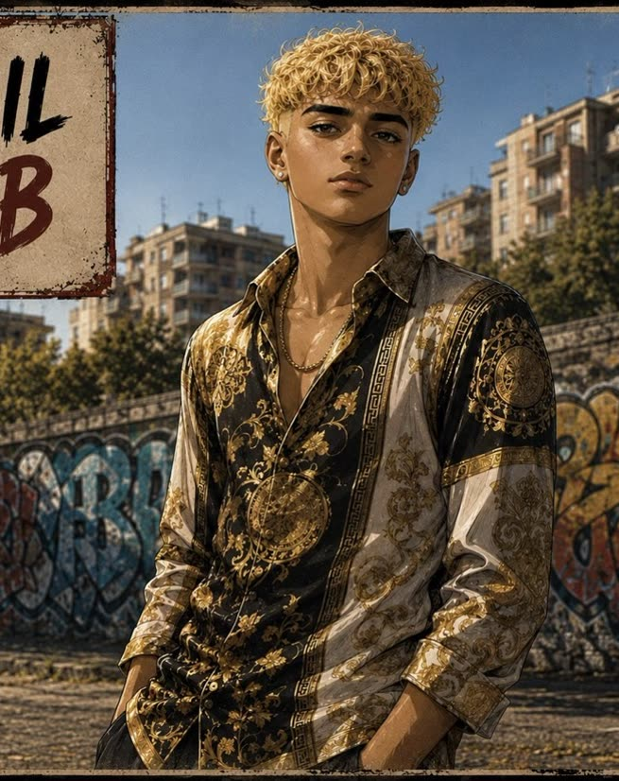
CHARACTERS
NABIL · 16
THE EYES. AND THE CAMERA.
Handsome, vain, hair always perfect, a TikTok smile. Raised more inside his phone than inside Rome. He isn’t really a criminal yet, but he wants to be one so badly that he becomes dangerous.
He looks harmless, the kid who brings the bubble tea.
Opens @bengalboy.it, an account nobody can trace back to him.
Goes live from Via Giulia with Tumi Amar playing underneath.
Shoots with his right hand and films with his left.
SEASON ARC
From the kid who wants to be a criminal to the one who films a friend dying. @bengalboy.it becomes a star, and he goes silent.
From the story

Slide 17
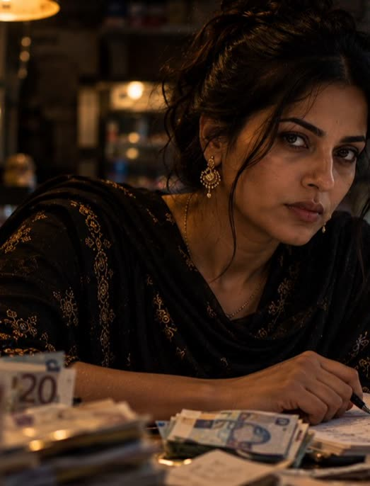
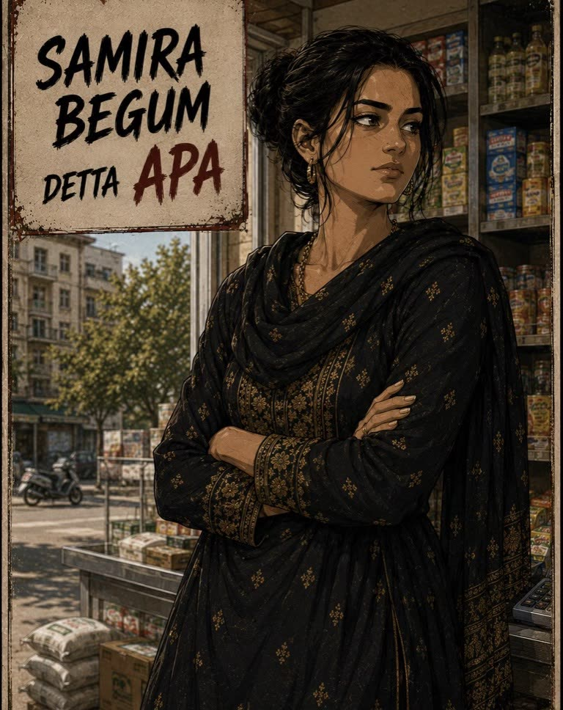

CHARACTERS
SAMIRA BEGUM · 32
THE BRAIN. AND THE VOICE.
The “big sister.” She doesn’t deliver, doesn’t run, doesn’t raise her voice. She runs the Dhaka Mini Market, grocery and money transfer. Everyone passes through her sooner or later. She comes from Sylhet and writes everything down in her ledger.
✓ I know who has.
✓ I know who owes.
✓ I know who’s moving money.
✓ I know who’s lying.
✓ I know who’s scared.
✓ I know who’s about to run.
✓ I know who talks too much.
✓ I know who keeps their mouth sewn shut.
SEASON ARC
From the woman who keeps other people’s accounts to the one who decides everyone’s fate. She sets the final trap, sends the boys away and stays.

Slide 18
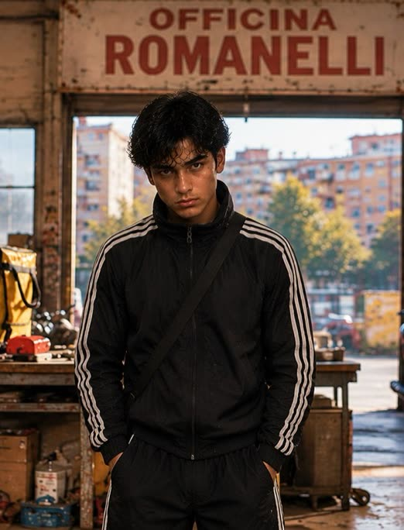

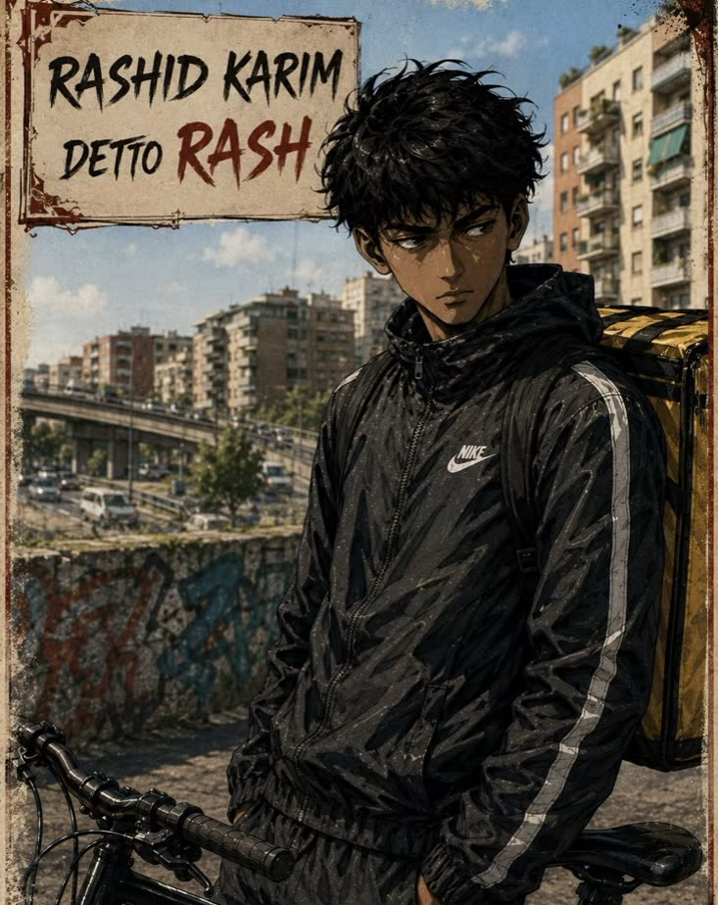
CHARACTERS
RASHID KARIM · 25
THE NAVIGATOR.
Rail-thin, sharp eyes, a Nike tracksuit even in summer. He’s been delivering since he was fifteen and knows Rome better than the cab drivers: shortcuts, open doorways, inner courtyards, service stairs.
Has the map of Rome printed in his brain.
Hardly ever speaks, but when Ibrahim says something, he understood it two minutes earlier.
He’s the first to know where to get in and where to disappear.
Chases the Dragona’s van by bike all the way to Torre Spaccata.
SEASON ARC
From the navigator who never speaks to the one who sees everything first. He’s the one who follows Ferro to the Dragona’s garage.
From the story

Slide 19
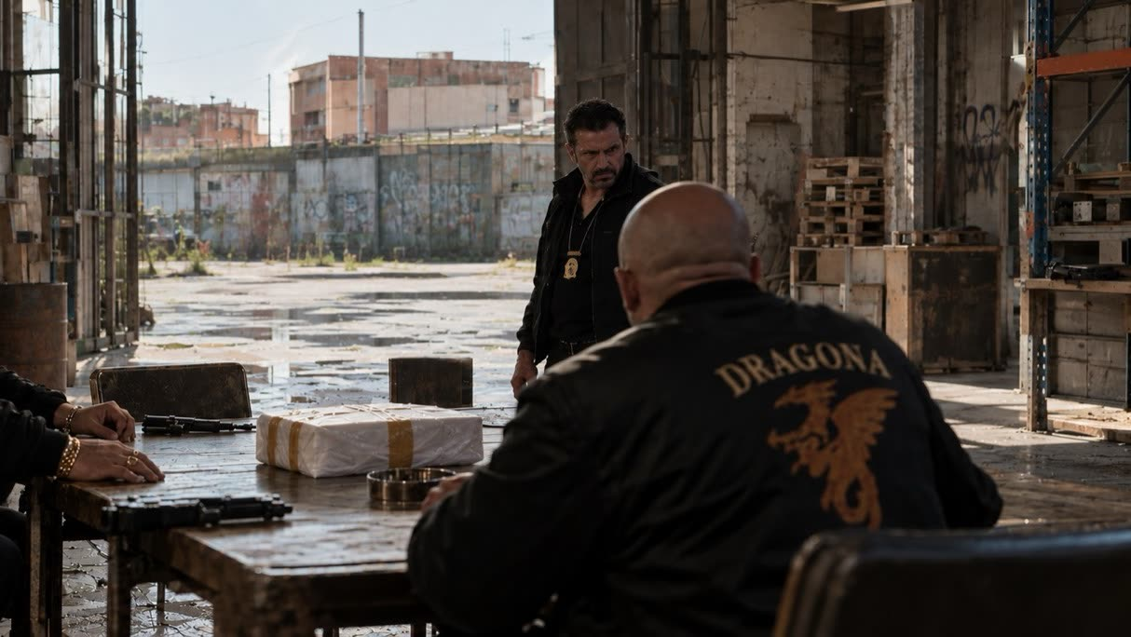
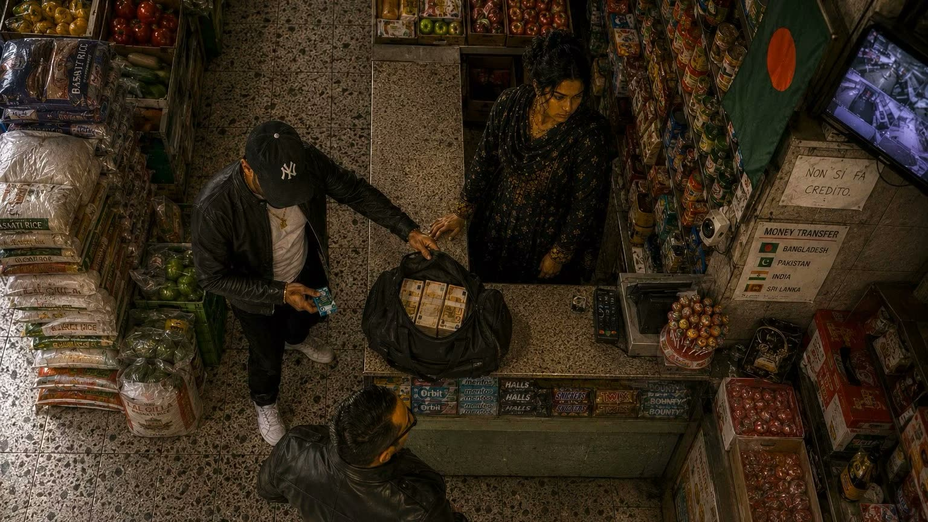
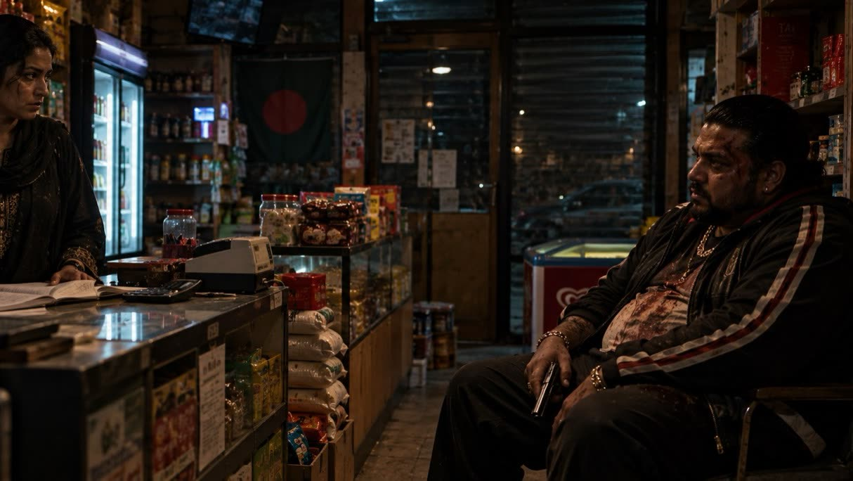



ANTAGONISTS
THE FAMILY
THE BADGE
THE MAN BEHIND THE KIDNAPPING
Vincenzo Dragona runs half of Rome. Only they lend at loan-shark rates, only they decide who opens and who burns. Nobody screws the Dragona.
Two Italians with shoes too expensive for their job. They buy the Gang’s kilo for fifty thousand euros. Then they get scared.
The community’s loan shark. He hires the Gang to kidnap Karim. He is the only one who survives the showdown.

Slide 20
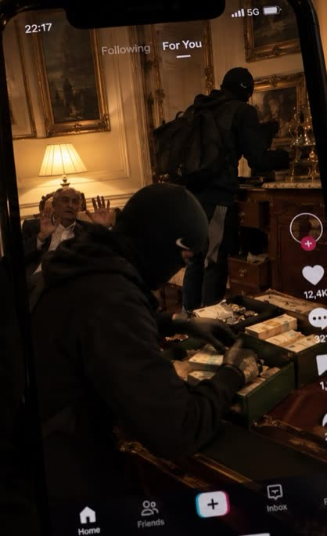

● LIVE
THE FOURTH ANTAGONIST
Nab’s account is both their ally and their enemy. Every robbery pushes the numbers up, and every video brings someone closer to the Dhaka’s door. In the series, the numbers mark the episodes.
@BENGALBOY.IT FOLLOWERS
EP. 3 · ACCOUNT IS BORN
1,240
EP. 4 · VIA GIULIA
26,000
EP. 7 · THE MELA
600,000
EP. 7 · 3 – DRAGONA 1
1,200,000
EP. 8 · SILENCE
1,400,000

Slide 21
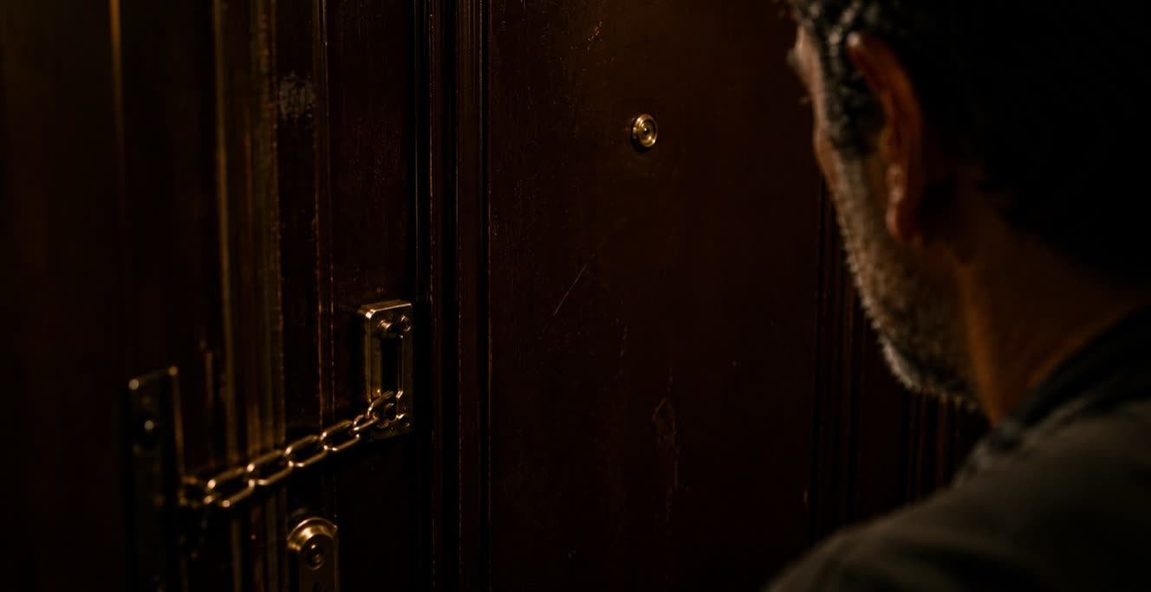
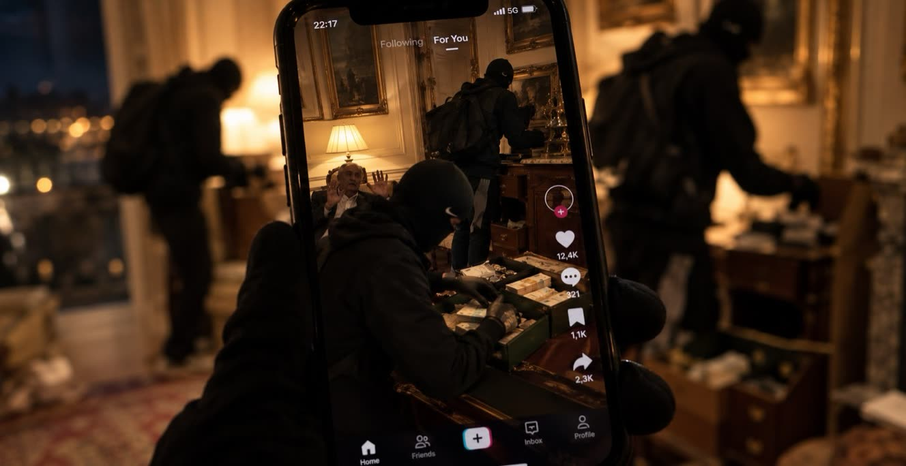
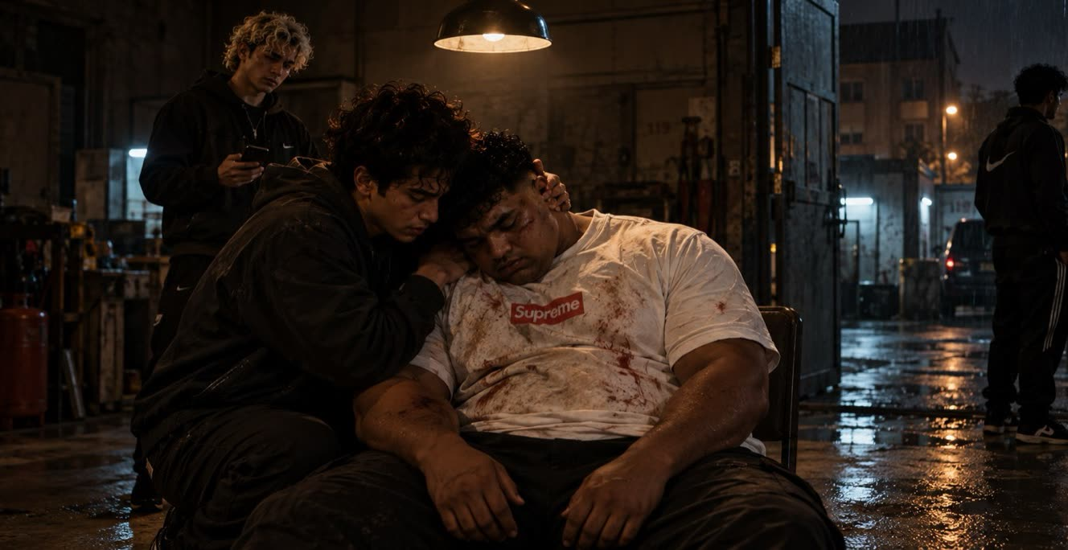



SEASON ONE
EPISODES 1–3
EPISODES 4–5
EPISODES 6–8
The job that changes everything, the kilo sold to the cops, the workshop. Nobody is watching them, and that’s their edge.
The Via Giulia livestream and the robberies in wealthy Rome. A million people are watching, and the city starts looking for them.
The kidnapping, Ferro’s death, Apa’s trap. Everyone knows who they are, and someone has to pay the bill.

Slide 22
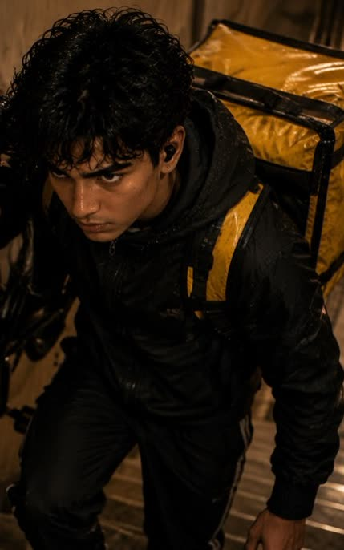
PILOT · EPISODE 1
TEASER
SEVENTEEN MINUTES
Pigneto, Casilina, Porta Maggiore, Caracalla, Trastevere. One hand on the handlebar, the other on the phone.
ACT 1
FIVE FLOORS
The bike on his shoulder, the door opening ten centimeters. The spray, the brass knuckles, the wardrobe.
ACT 2
DELIVERY COMPLETE
Tap yes. “Shohor amader.” Titles: bangla-tech and a generation dancing in front of the Colosseum.
ACT 3
TORRE ANGELA
The night ride east. The basement, the Gang. Apa’s voice introducing everyone.
FINALE
THE FLIP SIDE
If the city is ours, then everyone is looking for us.

Slide 23
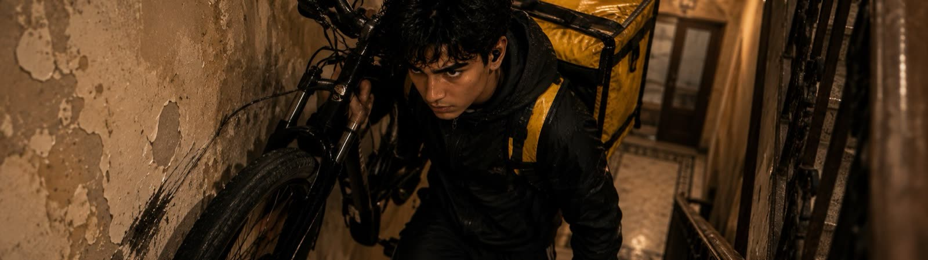

PILOT · EPISODE 1 OF 8 · PROLOGUE
Pinseria Verace in Pigneto, delivery to Via della Luce in Trastevere: seventeen minutes flat. Ibrahim climbs five floors with his bike on his shoulder, empties pepper spray into Massimo’s face and takes a kilo of the Dragona’s coke. “Delivery complete.” At night he rides to the basement in Torre Angela, where the Gang is waiting.
R
New delivery available · 17 min
NEW FOR THE SERIES
An ordinary rider’s day before the job, and where the tip came from.
ENDS ON “Shohor amader. Bhoy karor na.”

Slide 24
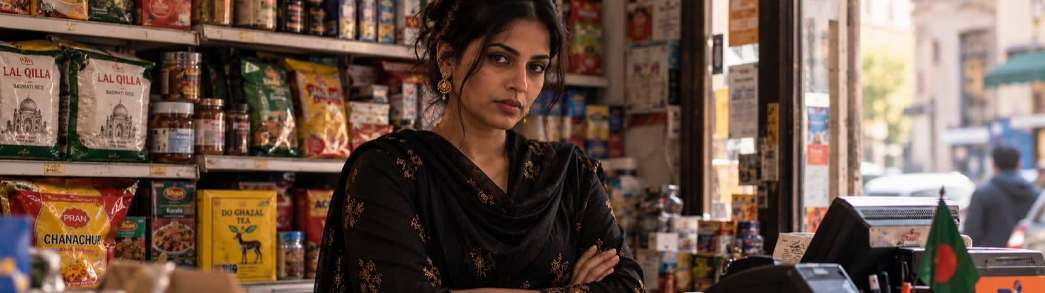

EPISODE 2 OF 8 · CH. I
Apa’s world: the shutter up at seven, money heading home, the NO CREDIT sign. Apa sells the kilo to two corrupt cops for fifty thousand euros: fifty thousand alive is better than a hundred thousand dead. The Dragona beat Massimo and have him killed. Before he dies he talks about a “Moroccan” rider.
R
Money transfer · €50,000 stays in Rome
NEW FOR THE SERIES
The Dragona’s hunt begins in the kebab shops and bars of East Rome.
ENDS ON The Dragona know they’re looking for a rider.

Slide 25
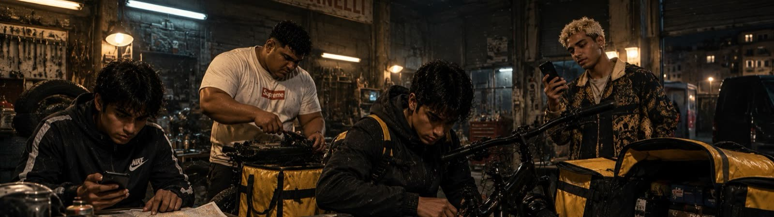

EPISODE 3 OF 8 · CH. II
The money doesn’t go back to Bangladesh. The Gang rents the Officina Romanelli in Ponte di Nona and rebuilds the bikes: boosted batteries, motors hidden in the hubs, thermal bags with false bottoms. Then the guns arrive. Apa closes her ledger and thinks of the Ratargul forest.
@
@bengalboy.it · 1,240 followers
NEW FOR THE SERIES
The first test robbery, no cameras. Nab opens @bengalboy.it.
ENDS ON The bikes ready and a tip about Via Giulia.

Slide 26
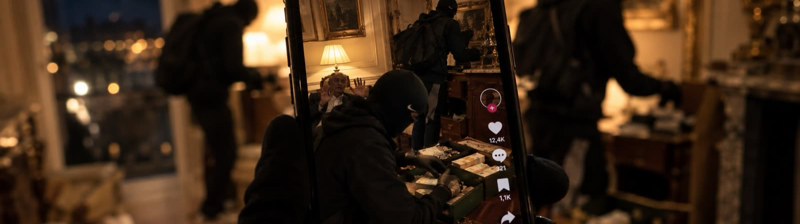

EPISODE 4 OF 8 · CHS. III–IV
Via Giulia, Friday night. “Delivery for Avedisian.” Nab goes live at 11:03 p.m., with Tumi Amar playing underneath. Rash throws punches looking into the lens, Ibrahim opens the green cash box: eighty-five thousand euros. Then the three race along the Lungotevere, singing. Within four minutes the algorithm goes crazy.
@
@bengalboy.it · live · 26,000 followers
NEW FOR THE SERIES
The night of the comments, lived by the viewers.
ENDS ON “Soon brother, soon.”

Slide 27
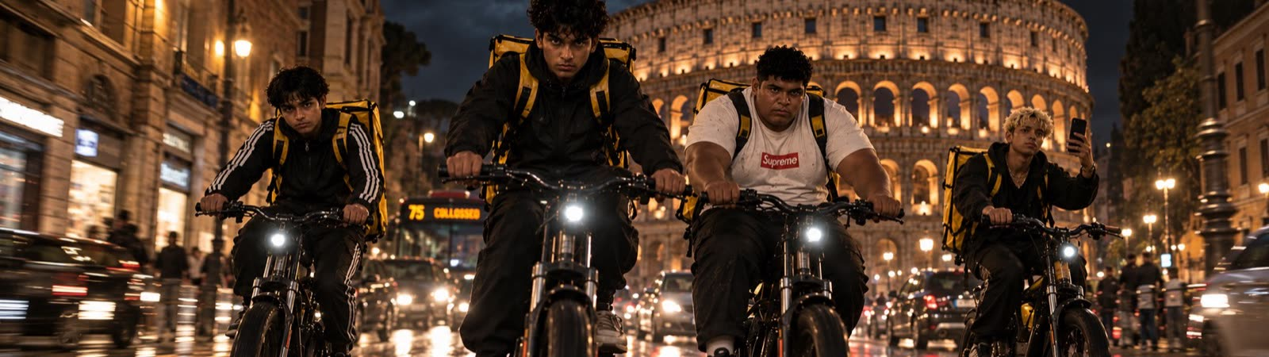

EPISODE 5 OF 8 · CH. V
Four robberies in three weeks. In Parioli Ferro gives the Patek back to the mother. In Flaminio he pins a young man down without a bruise. In Prati he leaves the caregiver alone. In Monteverde an old woman sees their faces and says “good evening.” The video hits a million. Then the roadblocks, and Bengalis beaten up on every corner.
@
@bengalboy.it · 1,000,000 views
NEW FOR THE SERIES
More jobs, bolder and bolder. The community splits.
ENDS ON A man in loafers at the Dhaka counter. “@bengalboy.it.”

Slide 28
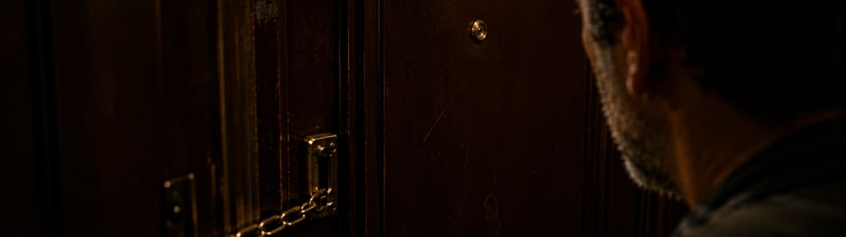

EPISODE 6 OF 8 · CHS. V–VI
Babu wants his money back from Karim: a hundred thousand euros on a loan that started at ten thousand. Ibrahim agrees. Just once. In Torpignattara Ferro pulls Karim into a stolen Fiat Bravo. At the workshop, left alone, Ferro lifts his balaclava to eat. “You’re Farhan, Uncle Miah’s son.” He regrets it at once. He’s a dead man.
@
@bengalboy.it · 104,000 likes
NEW FOR THE SERIES
The world of kidnappings in the community, the code of silence, Karim’s family.
ENDS ON Karim smothered in the chair, Ferro finishing his rice.

Slide 29
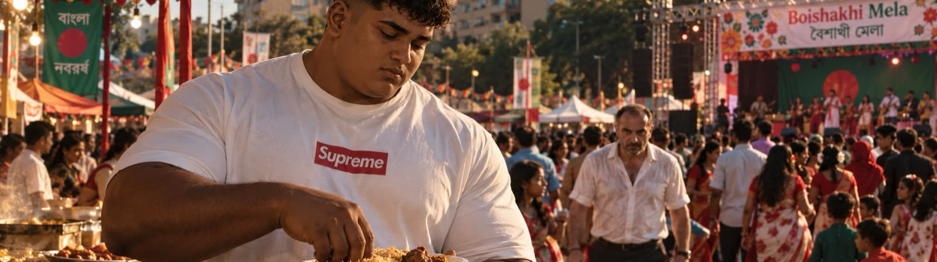

EPISODE 7 OF 8 · CHS. VII–VIII
Bengali New Year in Largo Preneste. Ferro eats chicken rice under a tree. An Italian in a white shirt lets him feel the gun barrel. Rash chases the van to Torre Spaccata. Ibrahim and Nab go in shooting. Ferro dies three minutes later, without having said a word.
@
@bengalboy.it · 1,200,000 followers
NEW FOR THE SERIES
Ferro’s hours in the garage, and Apa’s, waiting for the phone.
ENDS ON “bengalboy.it 3 – Dragona 1.”

Slide 30
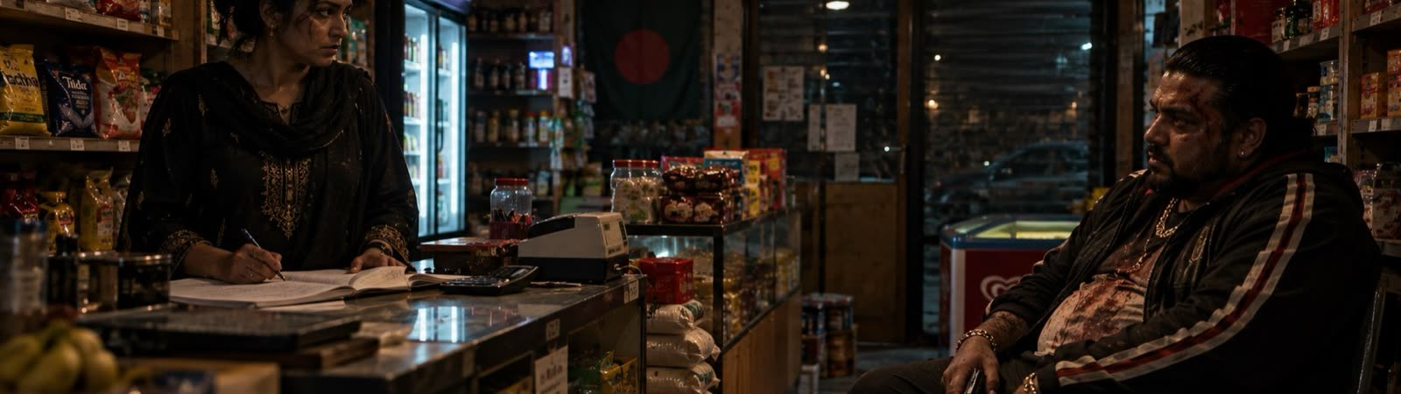

EPISODE 8 OF 8 · CHS. IX–XII
Apa puts three pieces together: the cops with the kilo, Babu who wants someone to blame, the Dragona who can’t lose face. She draws them to the same warehouse. When it all blows up the boys leave for the airport with three million spread across a thousand trickles. Apa stays. Babu walks into the Dhaka covered in blood. A point-blank shot.
@
@bengalboy.it · no new posts · 1,400,000
SEASON 2
But… Apa isn’t dead, and the boys never got on that plane.
ENDS ON Darkness, and her father’s boat among the flooded trees.

Slide 31
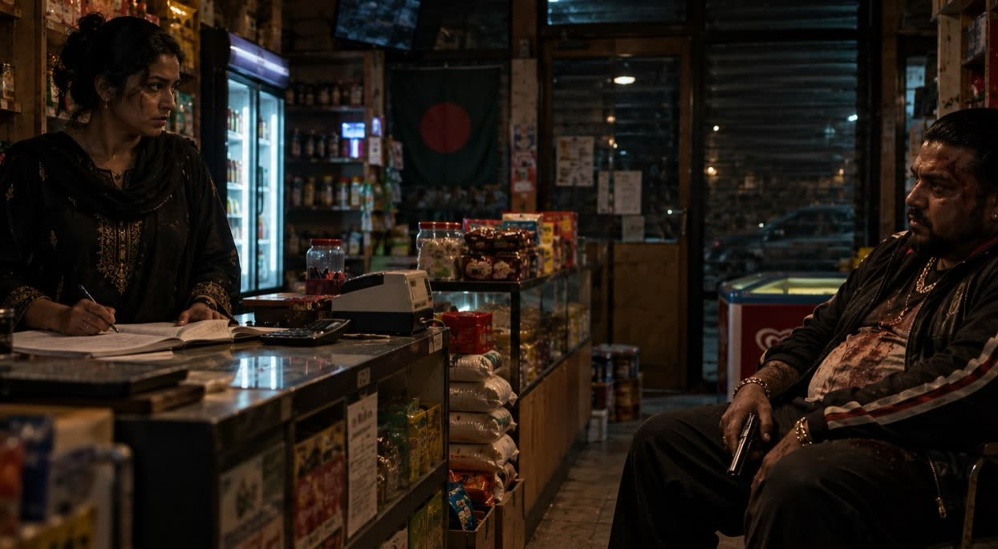



Apa isn’t dead. And the boys never got on that plane.
Apa wakes up from a coma and her kingdom is gone: the police have seized the Dhaka. Then an accountant nobody knows comes looking for her. He knows about the books, the thousand trickles, more than he should.
SEASON TWO
THE BOYS
They stay in Rome, hiding in plain sight inside the city that’s hunting them.
BABU AND THE DRAGONA
Two revenges that cross, and a debt nobody has paid.
@BENGALBOY.IT
One million four hundred thousand people are waiting for the next video.

Slide 32
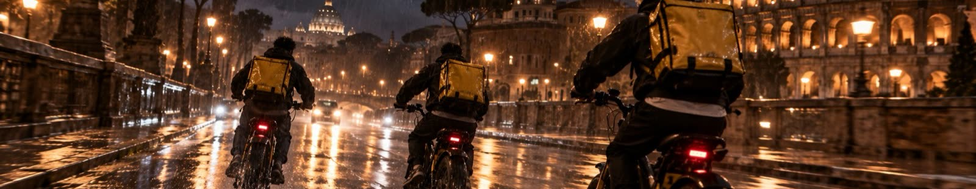
LOOK BOOK
WET ASPHALT
BACKPACK · MARIGOLD
SARI
FLAG · BLOOD
DHAKA SHOP SIGN
SODIUM LIGHT
LIGHT
CAMERA
SCREENS
Night, rain, sodium lamps and shop signs. Daylight belongs to the Dhaka, the workshop and Ratargul.
At bike height. One-take rides, the app’s timer on screen.
@bengalboy.it’s vertical videos enter the story with their comments.
MUSIC
LANGUAGE
FACES
Bangla-tech over the titles, Tumi Amar under the robberies, Esho he Boishakh at the Mela.
Primary: Italian or English. Secondary: subtitled Bengali. Plus Roman slang.
Performers from Rome’s Bengali community, Roman actors for the Dragona and the cops.

Slide 33
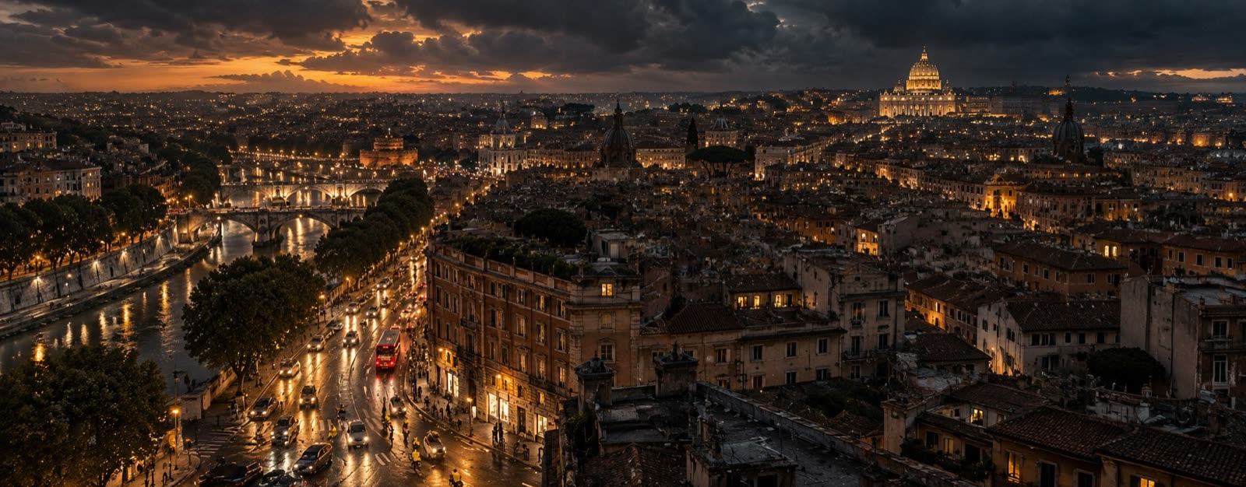
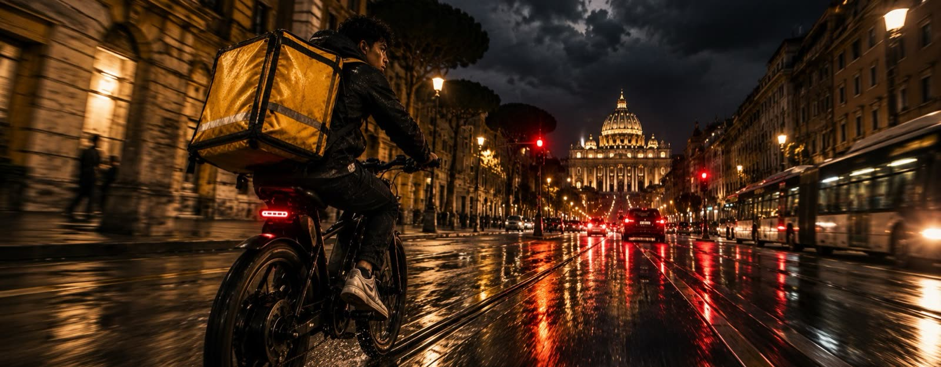
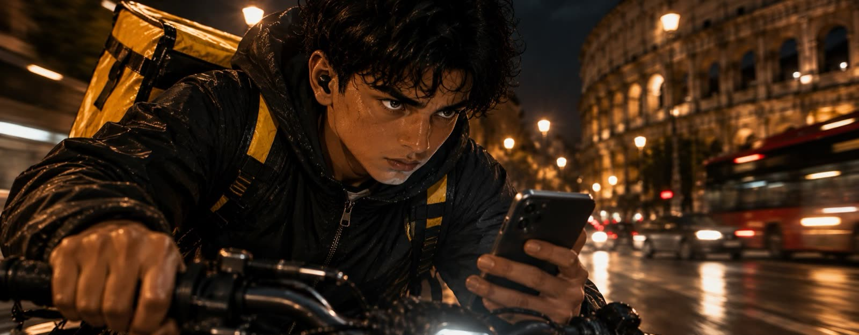













LOOK BOOK

Slide 34










LOOK BOOK
Apa
Ferro
Nab
Rash
In the saddle
The livestream
Boishakhi Mela
The tea stall
The opening titles
Lungotevere

Slide 35

BUDGET ESTIMATE
BUDGET BREAKDOWN
SEASON ONE · 8 × 50’
CREW AND SHOOTING
40–45%
CAST
12–15%
ABOUT €1.2–2M PER EPISODE
POST-PRODUCTION AND VFX
10–12%
LEANER VERSION
OVERHEADS
10%
Under €1M per episode, with more night interiors and fewer days in the historic center.
LOCATIONS AND PERMITS
8–10%
Indicative estimate based on average costs of high-end Italian crime series. Italy’s national tax credit and Lazio Region funds can cover a significant share of the costs.
DEVELOPMENT AND WRITING
5–7%
MUSIC AND RIGHTS
3–5%

Slide 36

THE STORY
A story by Massimo Scognamiglio. A prologue and twelve chapters, narrated by Apa.
AUTHOR
Massimo Scognamiglio
PUBLISHER
Independently published
ISBN
979-8-18214-364-6
LANGUAGES
English · Italian
READ THE STORY
THE AUTHOR
Artist, photographer, technologist and writer. For more than thirty years he has worked across visual arts, literature and digital innovation. He has exhibited at the MACRO and the Palazzo delle Esposizioni in Rome, and in 1996 he founded one of Italy’s first web companies in Rome. He also made the trailer.

Slide 37




The city is ours. Afraid of no one.
101.0
riders-on-the-storm.pages.dev/en
Bangla Pop on Spotify

